Slide 1

Study Information
Faculty of Economics
University of South Bohemia in České Budějovice
Czech Republic

Slide 2


Czech Republic
Area: 78,864 km²
Population: 10,266,000 inhabitants
Official language: Czech
Political system: Parliamentary republic
Head of State: President
Currency: 1 Czech crown (CZK)
Capital: Prague
Administrative division: 14 regions

Slide 3

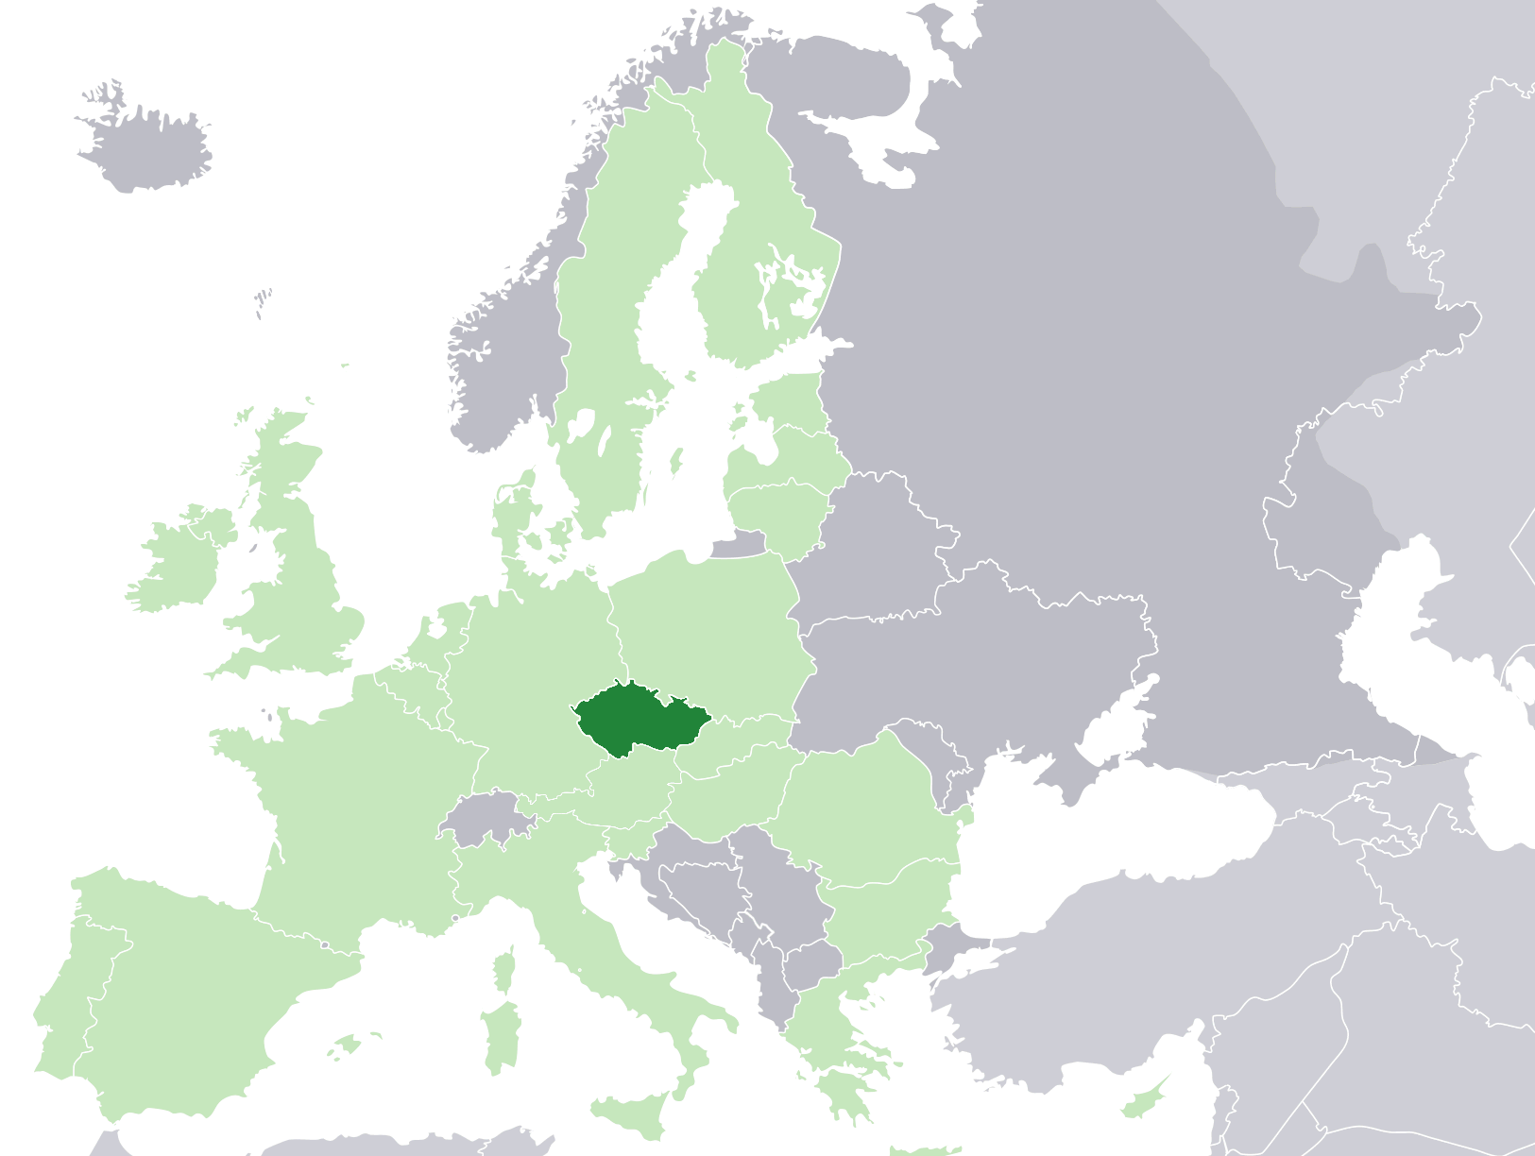
Czech Republic in Europe and in EU (green)

Slide 4
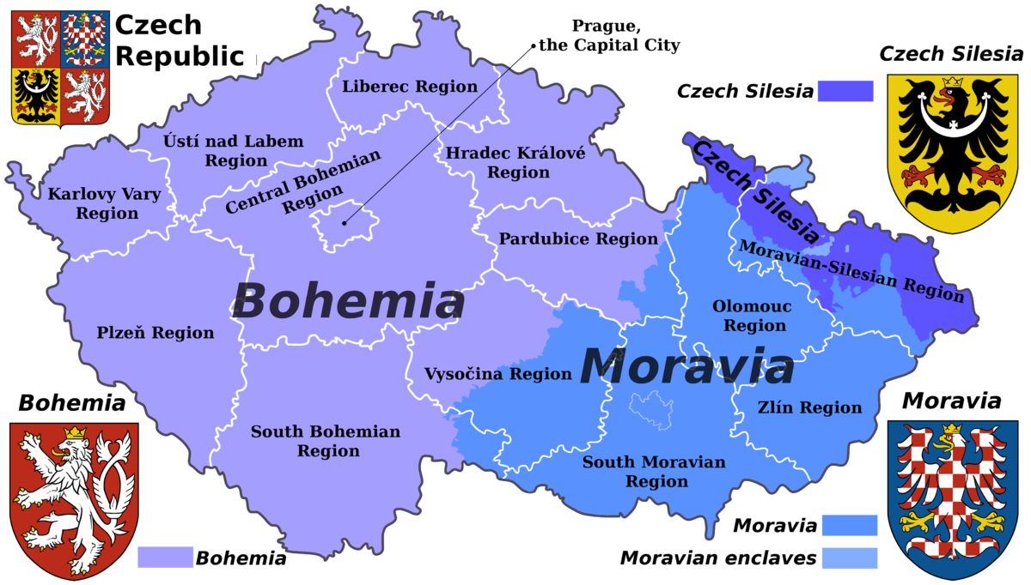
Administrative Division of Czech Republic

Slide 5
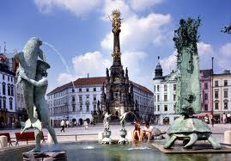
UNESCO Monuments in Czech Republic

Slide 6





Traditional Czech Brands

Slide 7
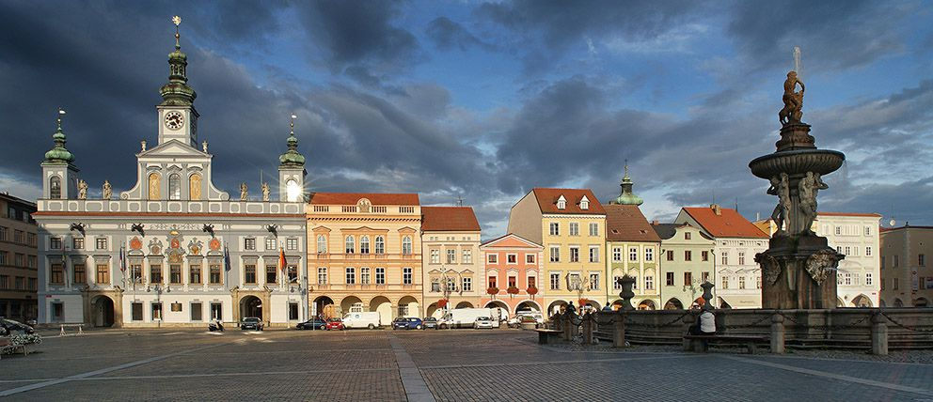
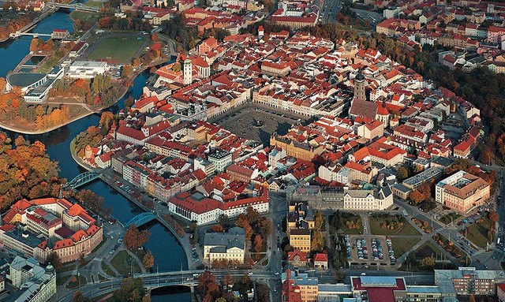

City of České Budějovice
capital of South Bohemia
100 000 inhabitants
founded in 1265

Slide 8
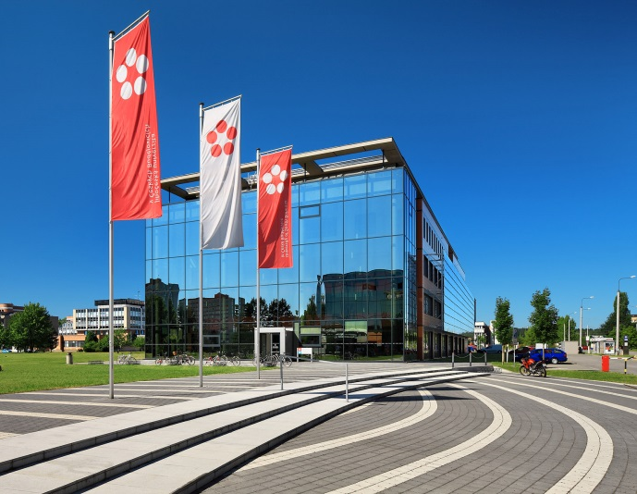
University of South Bohemia
founded in 1991
8 schools (faculties)
220 majors
12 000 students
1 800 employees
300 foreign students /academic year
prestigious Czech university, ranks 3-4 among universities in Czech Republic
    more info

Slide 9
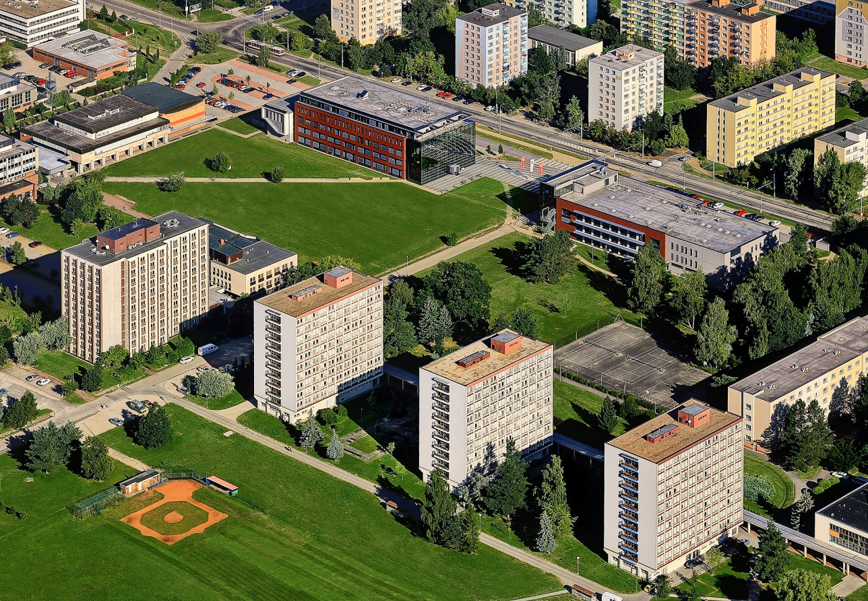
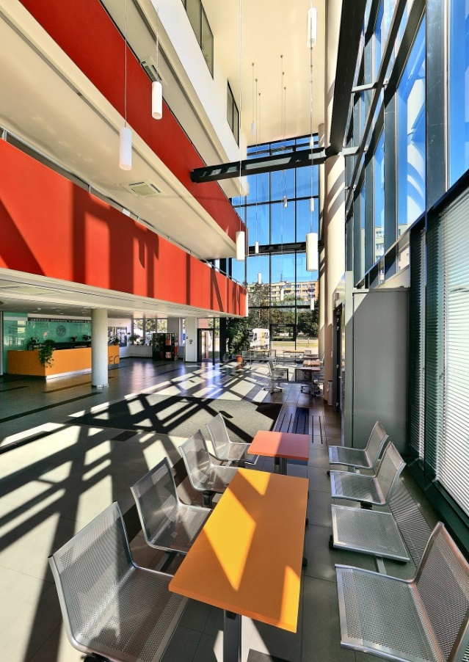
University Campus
university campus in a quiet area with links to the city park
modern library, dormitory, canteen and sports facilities

Slide 10
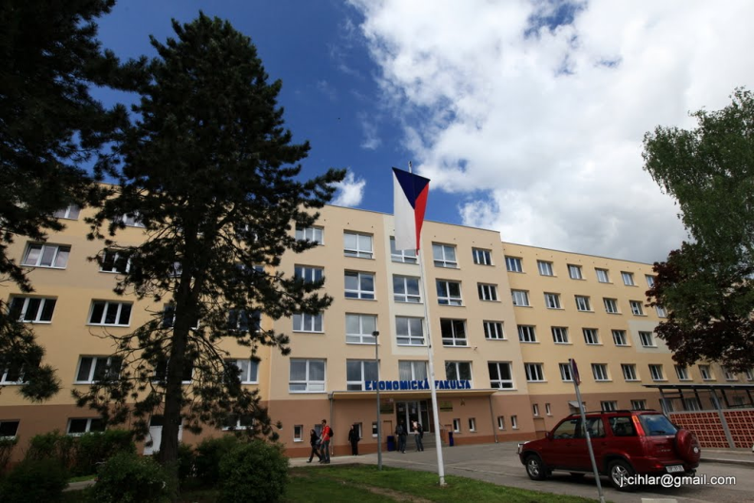
Faculty of Economics
founded in 2007
8 departments
12 majors
Bc, MA, PhD levels
1 600 students
80 members of academic staff
more than 40 partner universities from abroad
90 foreign students / academic year
  more info

Slide 11
Why to Study with Us
  Study in English
  Low living costs
  International environment
  Good geographical location
  Clean and safe environment
  New approaches to education
  Internship in global companies
  Study in English
  Low living costs
  International environment
  Good geographical location
  Clean and safe environment
  New approaches to education
  Internship in global companies

Slide 12
Study Possibilites
Full degree majors in English
  Economic Informatics (undergraduate)
  Commerce and Entrepreneurship (postgraduate)
  Management and Business Economics (doctoral)
Exchange certified courses
  more than 50 courses presented fully in English
Summer school
    focus on International Business
          more info

Slide 13
Degree in Economic Informatics (undergraduate)
  Core subjects
  Computer Science: Basic Programic, Database Systems, Web Design, Business Information Systems, Information and Communication Networks
  Economics: Microeconomics, Macroeconomics, Principles of Accounting
  Management and Marketing: Management, Marketing, Project Management, Law
  Optional subjects
  E-business, E-commerce, Multimedia etc.
Typical careers
    Information system analyst, application system manager, business consultant
Entrance Requirements
  Skype interview - interest, Computer Science, English (B1 level = min 42 points TOEFL)
Length and cost
  standard study: 3 years, intensive study: 2 years
  1,500 EUR / semester
    more info

Slide 14
Degree in Commerce and Entrepreneurship (postgraduate)
Core subjects
  Trade: Strategic Marketing, Consumer Behaviour, International Trade, Marketing Communication, International Tourism
  Economics: Advanced Microeconomics, Advanced Macroeconomics, Managerial Economics
  Management: Human Resource Management, Strategic Management in Trade and Tourism, Logistics
Optional subjects
  Economic and Social Statistics, Quality Management, Fair Trade, International Finance, Environmental Economy, Consumer Protection etc.
Typical careers
  Trade Professional, Marketing Professional, Retail Manager, Logistics Manager, Tourism Consultant
Entrance Requirements
  Skype interview - interest, Commerce, Economics, English (B1 level = min 42 points TOEFL)
Length and cost
  standard study: 2 years, 2,000 EUR / semester

Slide 15
Certified Courses
More than 50 courses in English (below some examples)
  Economics: Microeconomics, Macroeconomics
  Finance and Accounting: Principles of Accounting, Securities, Public Finance, Financial Analysis, Managerial Accounting
  Mathematics and Informatics: Mathematics, Probability and Statistics, Models of Decision Theory, Econometrics, E-business
  Management: Project Management, Strategic Management, Logistics, Human Resources Management, Supply Chain Management
  Languages: Business English, English for IT and Business, English for Commercial Management
  Law: Introduction to the EU Law
  Regional Management: Environmental Management, Rural Sociology, Green Economy and Sustainability
  Trade and Tourism: Marketing Research, International Trade, Business Stimulation, Strategic Marketing, Marketing Communication
Length and cost
  1 semester, 200 EUR / 1 course
          more info

Slide 16
Summer School
European Culture and Business Environment
  lectures on European Culture, European Business Environment, European Union, and European Integration, and European Law
  excursions to local companies such as Budweiser brewery, trips to Český Krumlov, Vienna
  participaon together with Australian students (from Victoria University in Melbourne)
  max. 18 students from China
Length and cost
  2 weeks (starting at end of June 2018)
  Accomodation 100 EUR (whole stay)
  Catering 10 EUR / day
  Registration fee (excursions, trips) 250 EUR

Slide 17
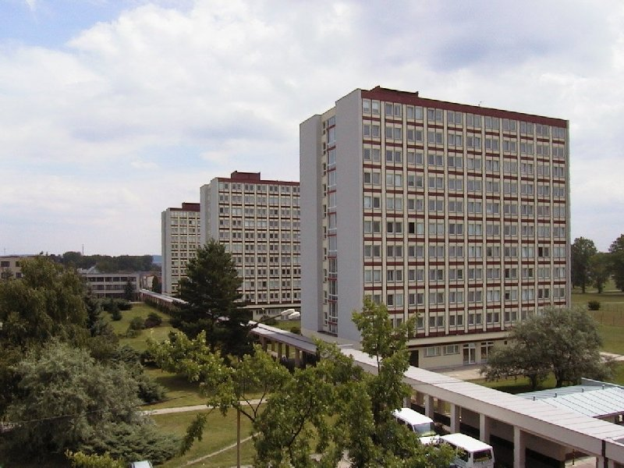
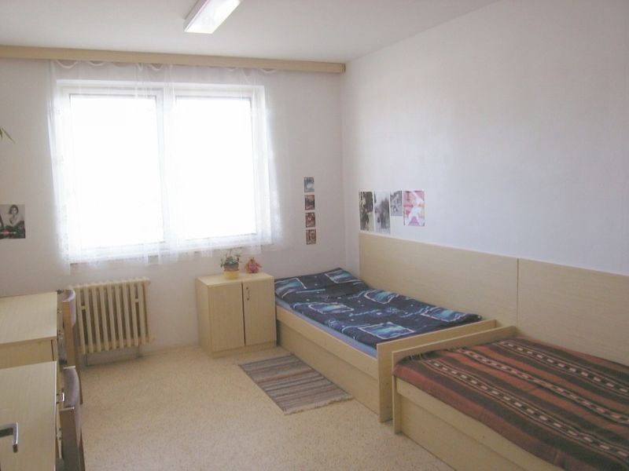
Accommodation
price 100 EUR/ month
twin room (2 rooms sharing toilet and shower facility)

Slide 18
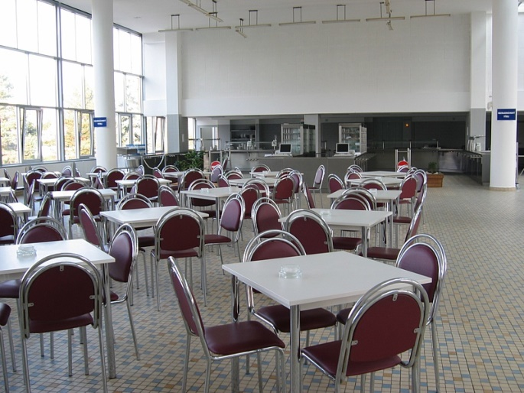
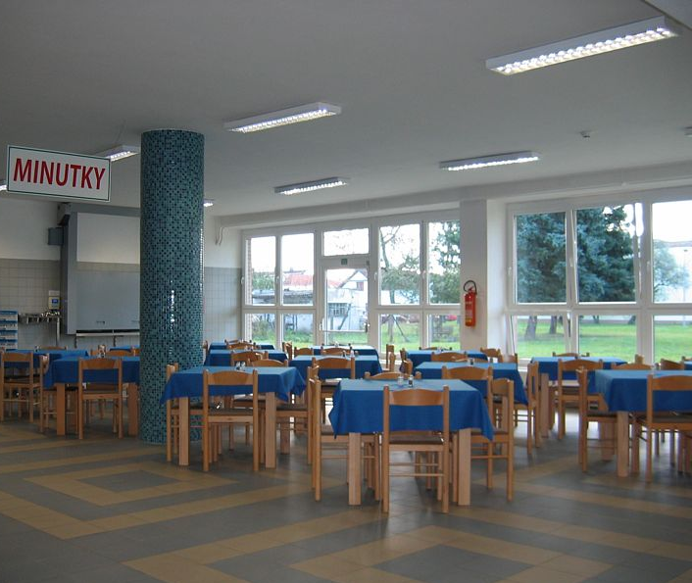
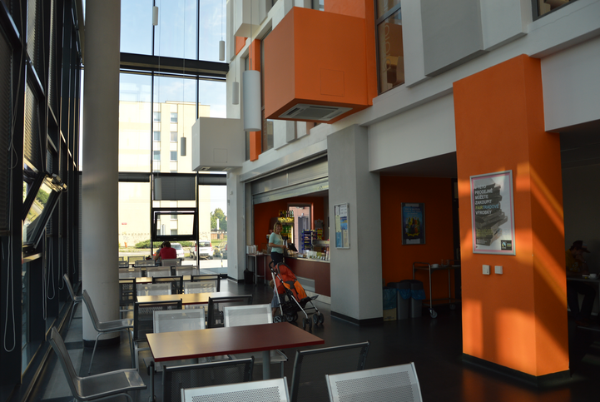
Catering
daily costs 10 EUR / day
university canteen offers breakfast, lunch and supper
university café offers hot and cold drinks and snacks

Slide 19
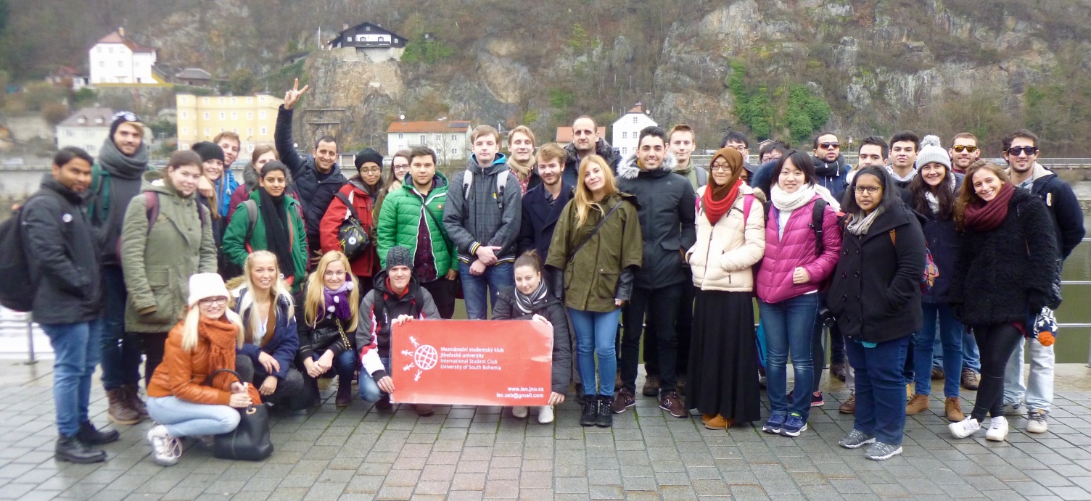
International Environment
90 foreign exchange students / academic year at Faculty of Economics
more than 40 partner universities participating in exchange programme located in: Australia, Austria, Bulgaria, Finland, France, Greece, Germany, Hungary, Italy, Ireland, Ireland, Lithuania, Slovakia, Slovenia, Poland, Portugal, Spain, Turkey, USA
more than 300 exchange students / academic year at whole university

Slide 20
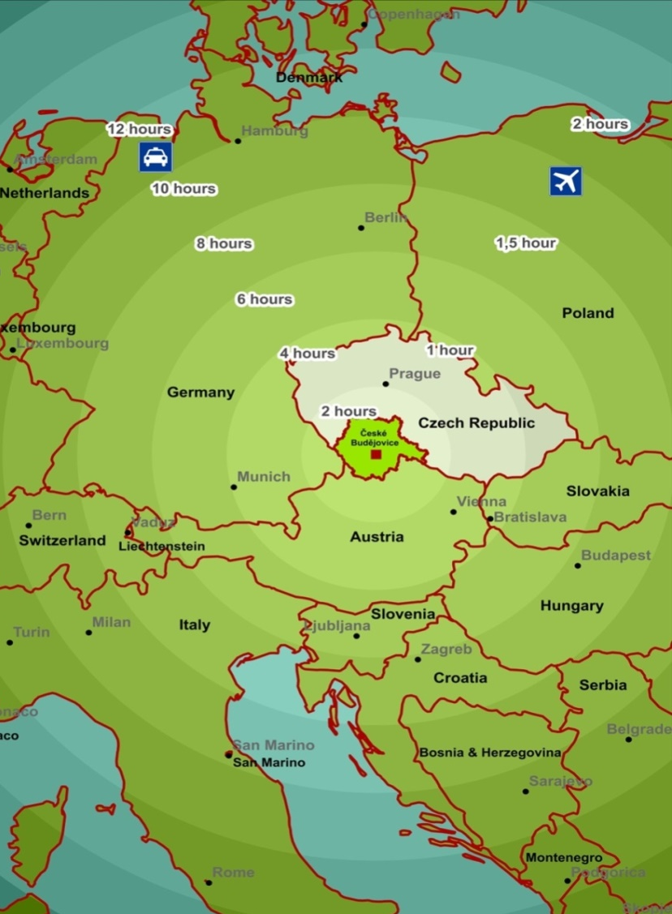
Location in Middle of Europe
Convenient location on the border of three countries:
  100 km to Linz (Austria)
  130 km to Passau (Germany)
  150 km to Prague
  200 km to Vienna (Austria)
  300 km to Munich (Germany)
  400 km to Budapest (Hungary)

Slide 21
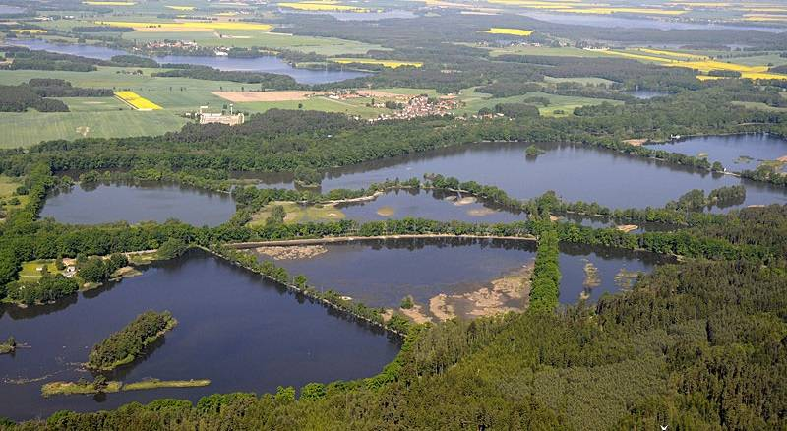
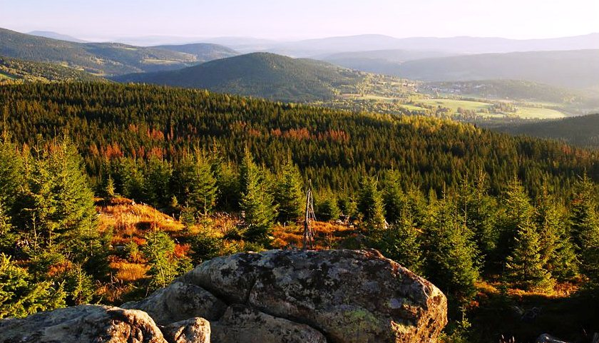

Catering
the cleanest and recreational region of the Czech Republic
unpolluted environment
almost no industry
many bioreserves and national park

Slide 22

New Approaches to Education
    Educational process focuses also on:
    simulations of management and court processes;
    green economy which which is defined as an economy that aims at reducing environmental risks and ecological scarcities, and that aims for sustainable development without degrading the environment;
    bio economy which comprises those parts of the economy that use renewable biological resources from land and sea – such as crops, forests, fish, animals and micro-organisms – to produce food, materials and energy;
    pluralism in economy enriches teaching and research and reinvigorates the discipline and brings economics back into the service of society
    fair trade which is a social movement whose stated goal is to help producers in developing countries achieve better trading conditions and to promote sustainable farming.

Slide 23










Internship Partners

Slide 24
Contact
Websites: www.ef.jcu.cz
E-mail: international@ef.jcu.cz
Address:
University of South Bohemia
Faculty of Economics
International Office
Studentská 13
37005 České Budějovice
Czech Republic
Europe

