Slide 1

Faculty of Economics
University of South Bohemia in České Budějovice
Czech Republic
Basic Information

Slide 2


Czech Republic
Area: 78,864 km²
Population: 10,266,000 inhabitants
Official language: Czech
Political system: Parliamentary republic
Head of State: President
Currency: 1 Czech crown (CZK)
Capital: Prague
Administrative division: 14 regions

Slide 3

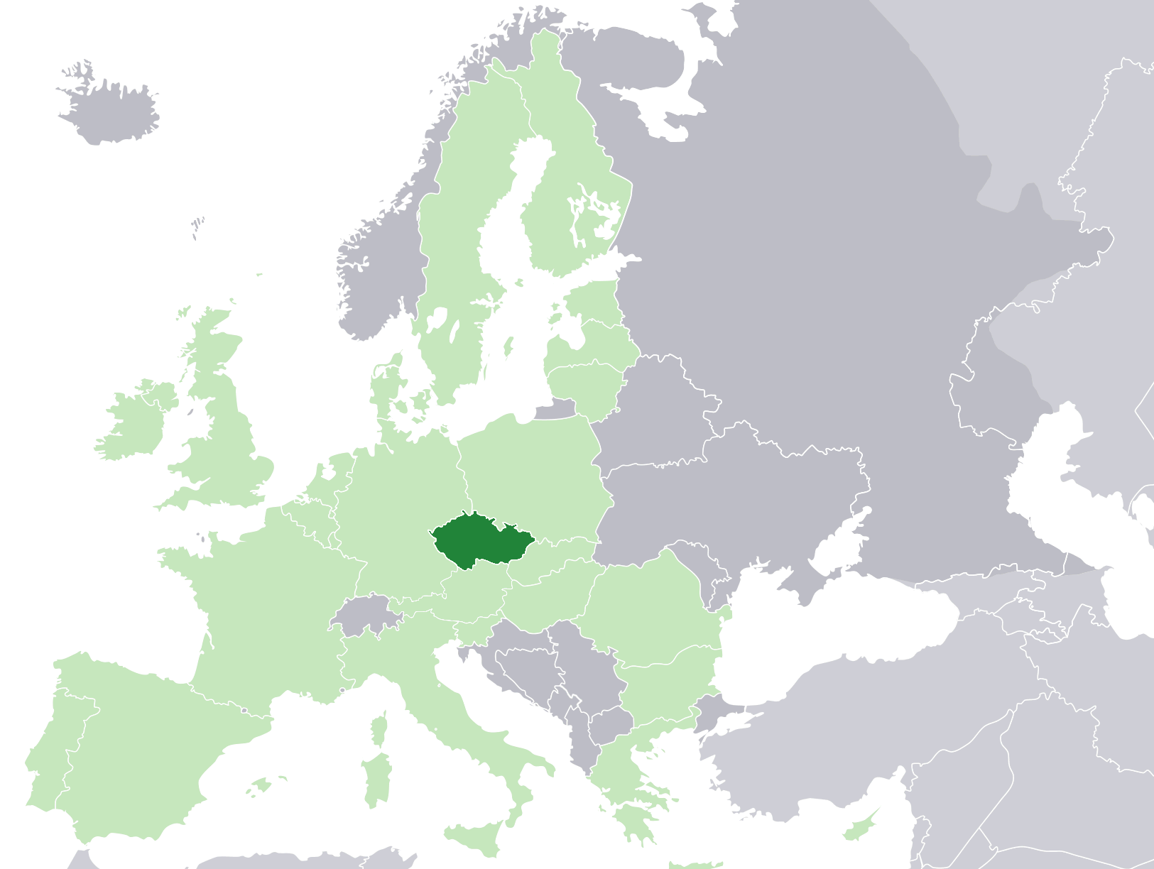
Czech Republic in Europe and in EU (green)

Slide 4
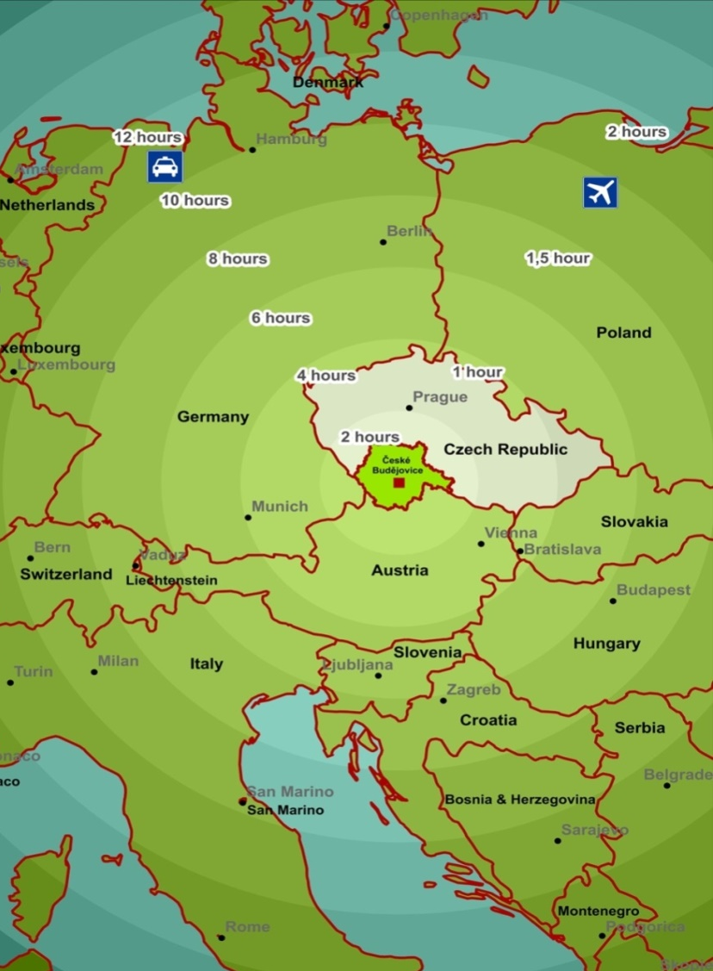
Location in Central Europe
Convenient location on the border of three countries:
  100 km to Linz (Austria)
  130 km to Passau (Germany)
  150 km to Prague
  200 km to Vienna (Austria)
  300 km to Munich (Germany)
  400 km to Budapest (Hungary)

Slide 5
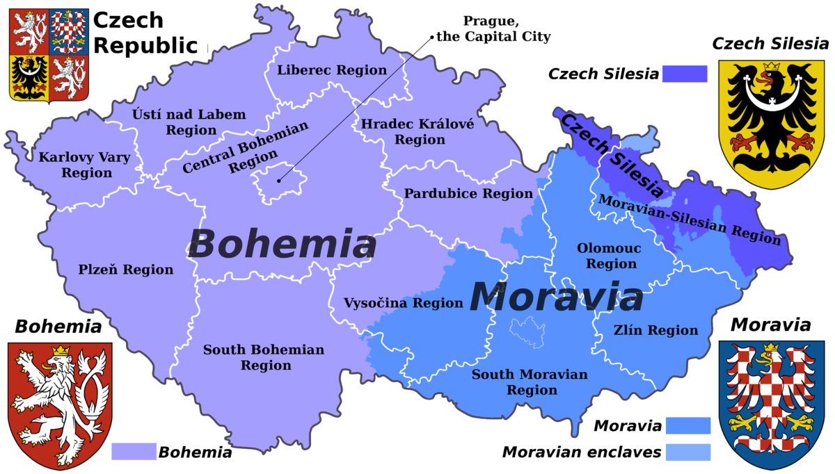
Administrative Division of Czech Republic

Slide 6
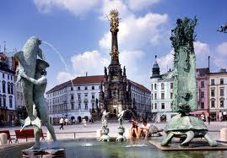
UNESCO Monuments in Czech Republic

Slide 7





Traditional Czech Brands

Slide 8
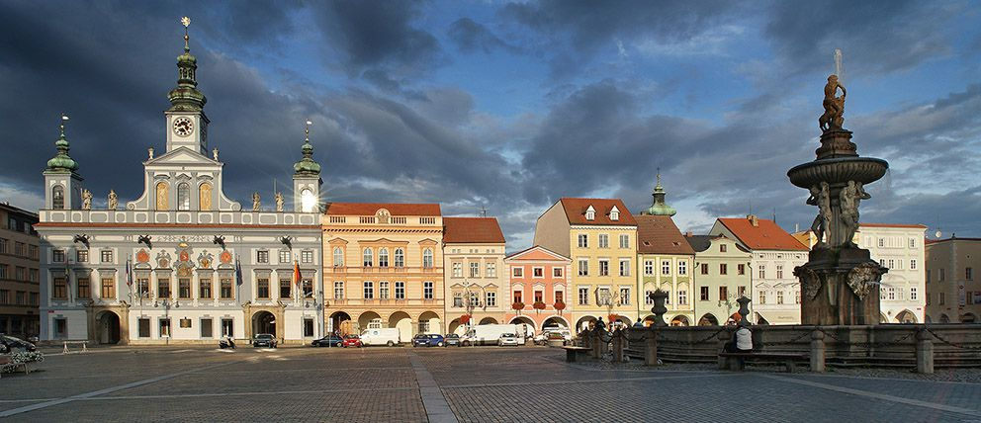
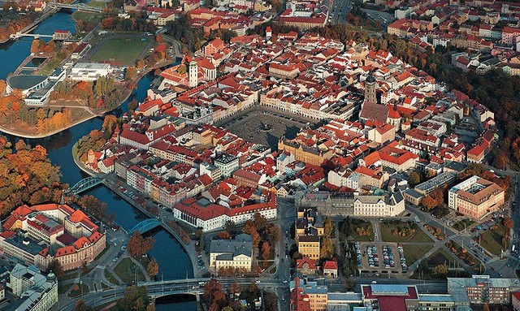

City of České Budějovice
capital of South Bohemia
100 000 inhabitants
founded in 1265

Slide 9

University of South Bohemia
founded in 1991
8 schools (faculties)
220 majors
12 000 students
1 800 employees
300 foreign students /academic year
prestigious Czech university, ranks 3-4 among universities in Czech Republic
    more info

Slide 10
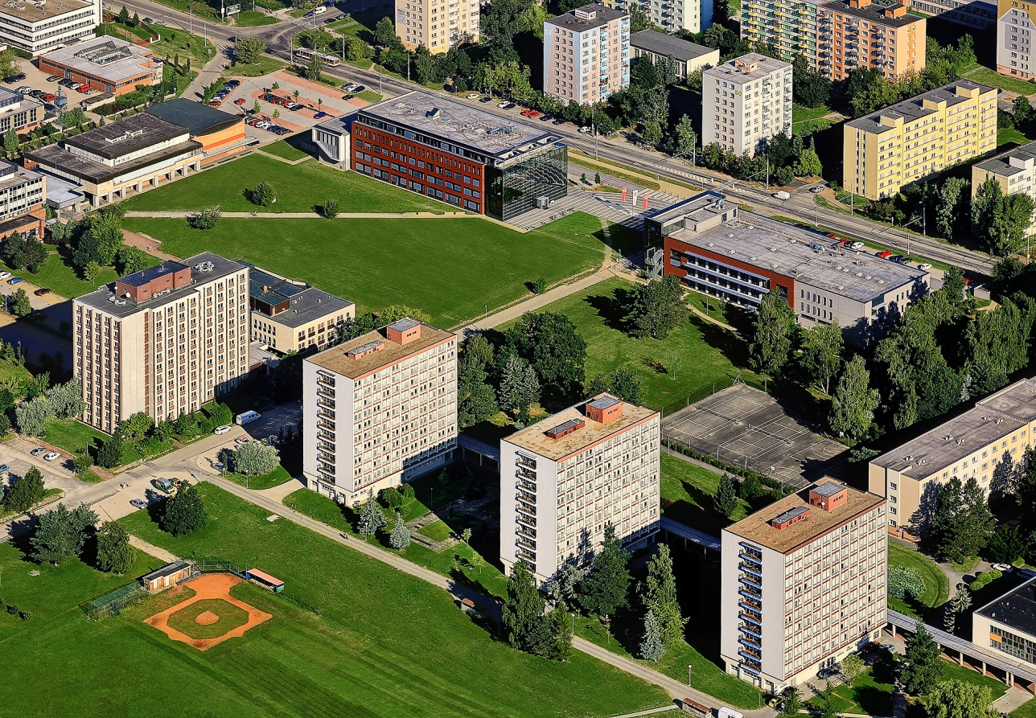
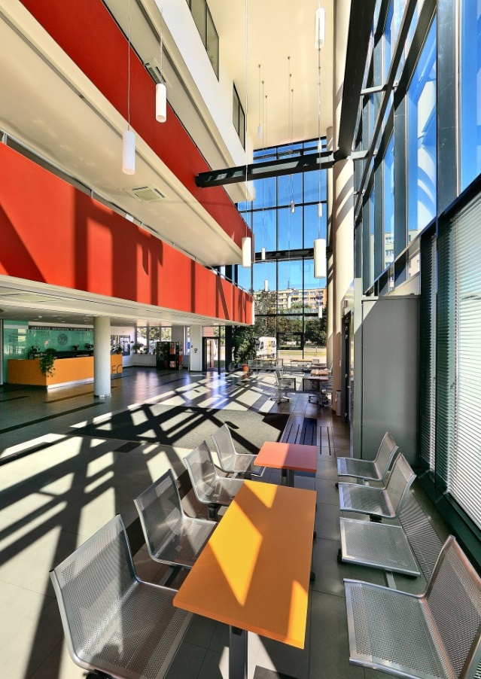
University Campus
university campus in a quiet area with links to the city park
modern library, dormitory, canteen and sports facilities

Slide 11
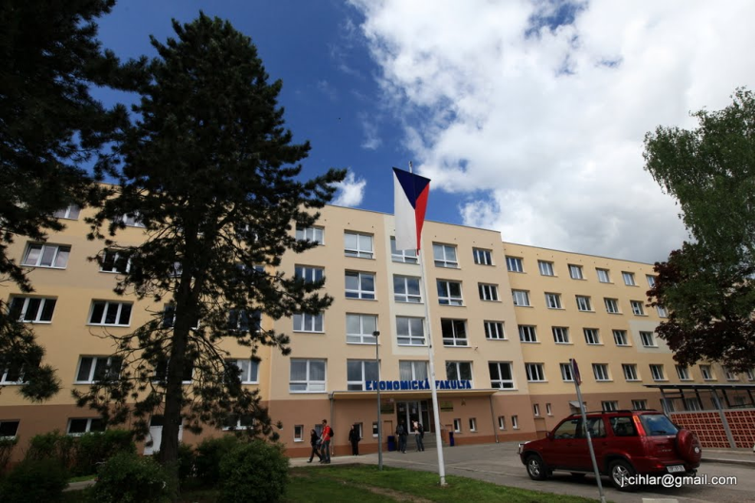
Faculty of Economics
founded in 2007
8 departments
12 majors
Bc, MA, PhD levels
1 600 students
80 members of academic staff
more than 40 partner universities from abroad
90 foreign students / academic year
  more info

Slide 12

Faculty Departments
Accounting and Finance
Applied Mathematics and Informatics
Economics
Regional Management
Law
Languages
Management
Trade and Tourism
  more info

Slide 13
Study Possibilites
Full degree majors – undergraduate
  Accountancy and Financial Management of Enterprise
  Economic Informatics (in Czech and English)
  Financial and Insurance Mathematics
  Management and Business Economics
  Management of Commerce
  Structural Policy of the EU for Public Administration
Full degree majors – postgraduate
  Accountancy and Financial Management of Enterprise
  Economic Informatics
  Management and Business Economics
  Management of Commerce
  Structural Policy of the EU and Rural Development
PhD degree
  Management and Business Economics (in Czech and English)

Slide 14
Study in English
Full degree majors in English
  Economic Informatics (undergraduate)
  Management and Business Economics (doctoral)
Exchange certified courses
  more than 50 courses presented fully in English
Summer school
    focus on International Business
          more info

Slide 15

New Approaches
    Educational process focuses also on:
    simulations of management and court processes;
    green economy which which is defined as an economy that aims at reducing environmental risks and ecological scarcities, and that aims for sustainable development without degrading the environment;
    bio economy which comprises those parts of the economy that use renewable biological resources from land and sea – such as crops, forests, fish, animals and micro-organisms – to produce food, materials and energy;
    pluralism in economy enriches teaching and research and reinvigorates the discipline and brings economics back into the service of society
    fair trade which is a social movement whose stated goal
    is to help producers in developing countries achieve better
    trading conditions and to promote sustainable farming.

Slide 16

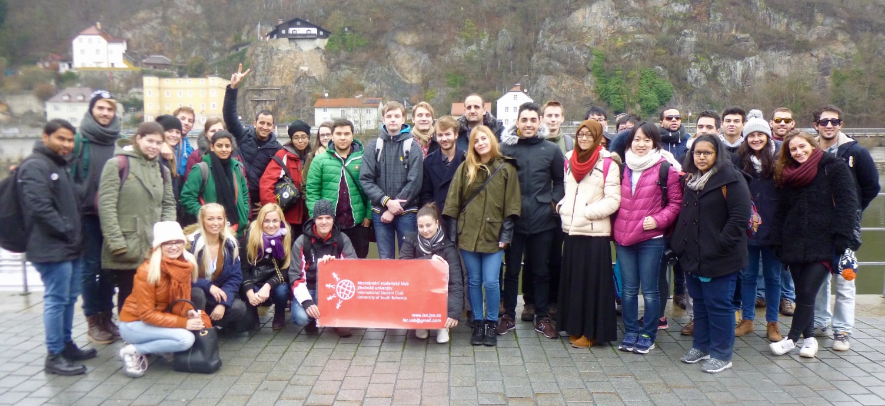
International Environment
90 foreign exchange students / academic year at Faculty of Economics
more than 40 partner universities participating in exchange programme located in: Australia, Austria, Bulgaria, Finland, France, Greece, Germany, Hungary, Italy, Ireland, Ireland, Lithuania, Slovakia, Slovenia, Poland, Portugal, Spain, Turkey, USA
more than 300 exchange students / academic year at whole university

Slide 17










Internship Partners

Slide 18
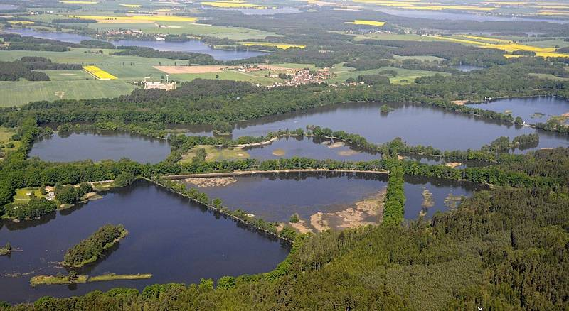


Clean Environment
the cleanest and recreational region of the Czech Republic
unpolluted environment
almost no industry
many bioreserves and national park

Slide 19
Contact
Websites: www.ef.jcu.cz
E-mail: international@ef.jcu.cz
Address:
University of South Bohemia
Faculty of Economics
International Office
Studentská 13
37005 České Budějovice
Czech Republic
Europe

