Slide 1
Faculty of Economics
University of South Bohemia in České Budějovice
Czech Republic
Basic Information
Marek Šulista Funchal, 21/06/2018

Slide 2
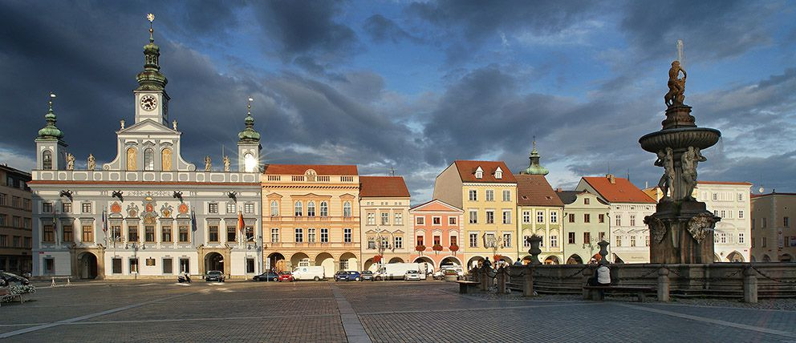
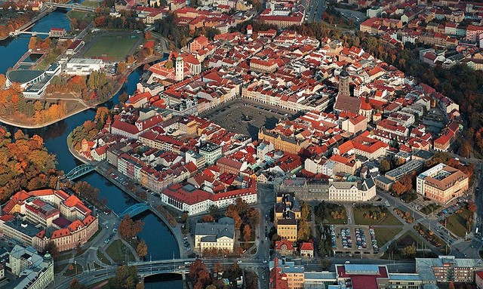
City of České Budějovice
capital of South Bohemia
100 000 inhabitants
founded in 1265

Slide 3
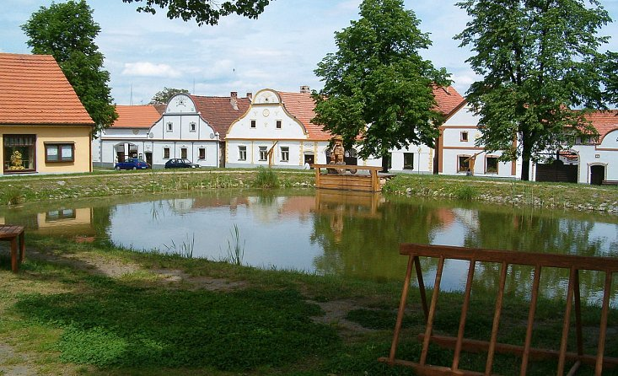
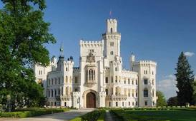
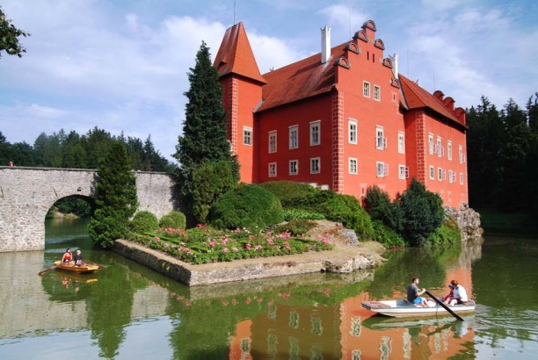
South Bohemia

Slide 4
University of South Bohemia
founded in 1991
8 schools (faculties)
220 majors
12 000 students
1 800 employees
300 foreign students /academic year
prestigious Czech university, ranks 3-4 among universities in Czech Republic
more info

Slide 5
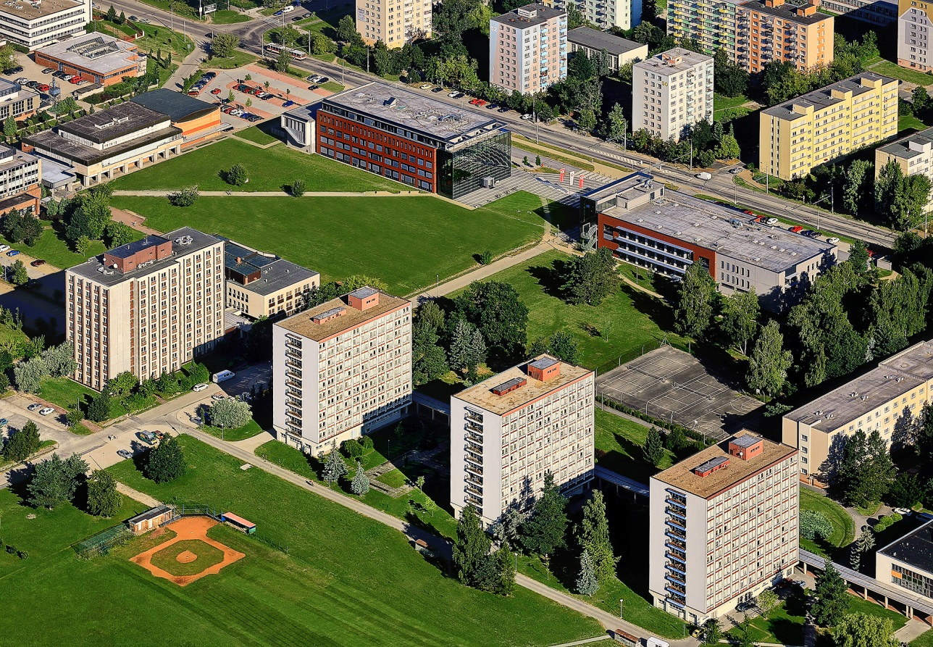
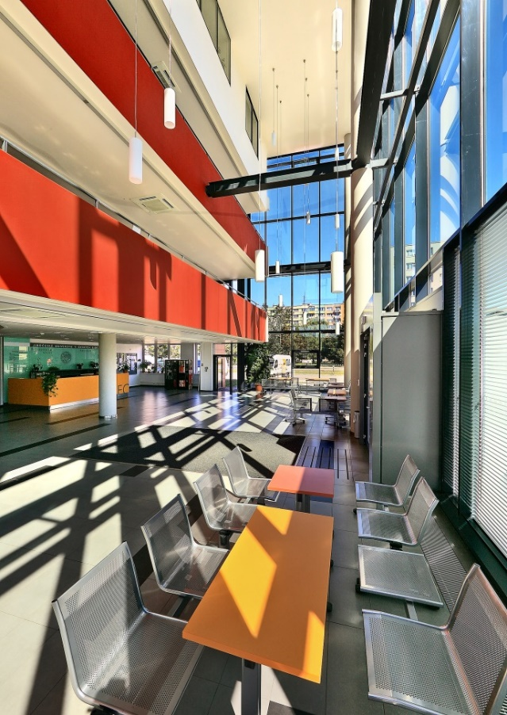
University Campus
university campus in a quiet area with links to the city park
modern library, dormitory, canteen and sports facilities

Slide 6
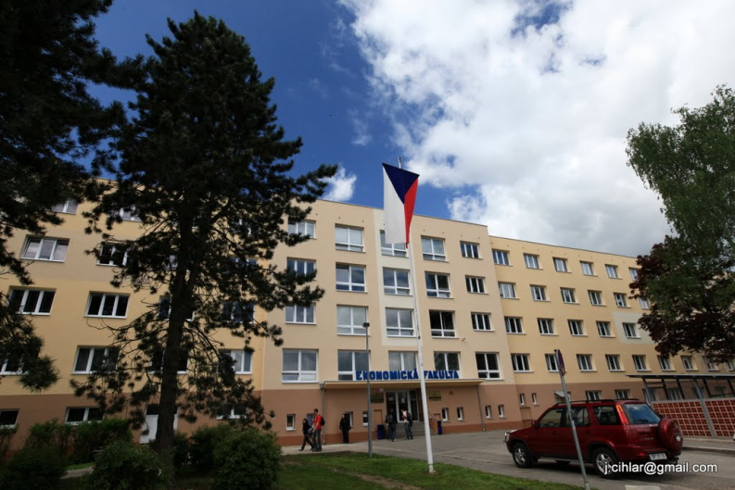
Faculty of Economics
founded in 2007
8 departments
12 majors
Bc, MA, PhD levels
1 600 students
80 members of academic staff
more than 40 partner universities from abroad
90 foreign students / academic year
more info

Slide 7
Faculty Departments
Accounting and Finance
Applied Mathematics and Informatics
Economics
Regional Management
Law
Languages
Management
Trade and Tourism
more info

Slide 8
Study Possibilites
Full degree majors – undergraduate
Accountancy and Financial Management of Enterprise
Economic Informatics (in Czech and English)
Financial and Insurance Mathematics
Management and Business Economics
Management of Commerce
Structural Policy of the EU for Public Administration
Full degree majors – postgraduate
Accountancy and Financial Management of Enterprise
Economic Informatics
Management and Business Economics
Management of Commerce
Structural Policy of the EU and Rural Development
PhD degree
Management and Business Economics (in Czech and English)

Slide 9
New Approaches
Educational process focuses also on:
simulations of management and court processes;
green economy which which is defined as an economy that aims at reducing environmental risks and ecological scarcities, and that aims for sustainable development without degrading the environment;
bio economy which comprises those parts of the economy that use renewable biological resources from land and sea – such as crops, forests, fish, animals and micro-organisms – to produce food, materials and energy;
pluralism in economy enriches teaching and research and reinvigorates the discipline and brings economics back into the service of society
fair trade which is a social movement whose stated goal
is to help producers in developing countries achieve better
trading conditions and to promote sustainable farming.

Slide 10
Study in English
Full degree majors in English
Economic Informatics (undergraduate)
Management and Business Economics (doctoral)
Exchange certified courses
more than 50 courses presented fully in English
Summer school
focus on International Business

Slide 11
Bilingual Aspects in Teaching of Mathematical Courses
Faculty of Economics
University of South Bohemia in České Budějovice
Czech Republic

Slide 12
Czech and English
Czech language
spoken only by 10 million speakers
territory of the Czech Republic
Indo-European / West Slavic language group
vocabulary influenced by Latin and German
English language teaching
compulsory from Grade 3 at elementary school level
compulsory at lower and upper secondary level
secondary school leaving examination – language level B1/B2

Slide 13
Promotion of English
Bachelor’s level
compulsory general English and English for Presentations
compulsory English for IT for students studying IT
optional conversation courses, Business English, Academic English, preparation courses for FCE and CAE
Master’s level
compulsory Business English
Courses offered in English
alternatives to courses presented in Czech
Courses presented in Czech
selected tasks English, English sources in qualification works, English summary

Slide 14
Bilingual Approach
Mathematical Courses in English
Mathematics I and II, Financial Mathematics, Theory of Probability, Statistics
mix of Czech and foreign students
bilingual textbooks
Mathematical software in English (Maple, Statistica, MS Excel)
some tasks in LMS Moodle in English (terminology, mathematical problems assigned in English)

Slide 15
Advantages
CLIL aspects:
introduction of the wider cultural context
preparation for internationalisation
improvement of overall and specific language competence
preparation for future studies abroad
preparation for future working life
development of multilingual interests and attitudes
diversify methods & forms of classroom teaching and learning
increase of learners’ motivation

Slide 16
Thank you for your attention!
Obrigado pela sua atenção!

